Slide 1
African Woman Rights and Privileges

Slide 2
Are Women’s Rights and Privileges Violated in Nigeria and other African States?
IIs Gender and Rights Equality Possible?
Is Gender and Rights Equality Not Possible?

Slide 3


What are Human Rights?
Rights according to United Nations Human Rights Declaration is a universal law that ought to be enjoyed and exercised by all individuals. According to this declaration, every human ought to have equal access to exercise the fundamental human rights. These rights include, right to life, right to freedom of speech, etc.

Slide 4

What are Human Rights?
According to Merriam Webmaster Dictionary, human rights are rights (such as freedom from unlawful imprisonment, torture, and execution) regarded as belonging fundamentally to all persons. Human rights are the basic privileges and freedoms that are meant or ought to be enjoyed by all individuals of a given society. Simply put, “human rights are the freedoms and benefits that accrue to all human beings,” irrespective of individuals’ beliefs, nationality, family, religion, moral, social and political standpoints.

Slide 5
Nigeria and Women’s Rights and Privileges

Slide 6

Does Nigeria respect women and human rights?
Does Nigeria violate women and human rights?

Slide 7

In Nigeria, women are denied certain inalienable rights.
Fact:
Since time immemorial the rights and duties of women in Nigeria have been subjected to the wishes and aspiration of their men counterpart,” and this has led to the denial of certain privileges and rights.

Slide 8
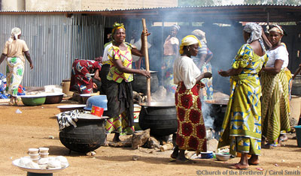
In Nigeria, women are denied certain inalienable rights.
Fact:
Nigeria societies reduces female gender as second class behind the males. Women in Nigeria are denied of certain comfort and enjoyment and growth despite all the available natural and human resources and as such women are defined by their ability to keep the home neat, nurture their children and work in pursuit of the success of their husband.

Slide 9

In Nigeria, women are denied certain inalienable rights.
Fact:
The social setting in Nigeria and other African states have been structured to inculcate the notions of inferiority in women and girls and superiority in men and boys right from childhood. Women are held down on the attainment of their goals and aspirations.

Slide 10
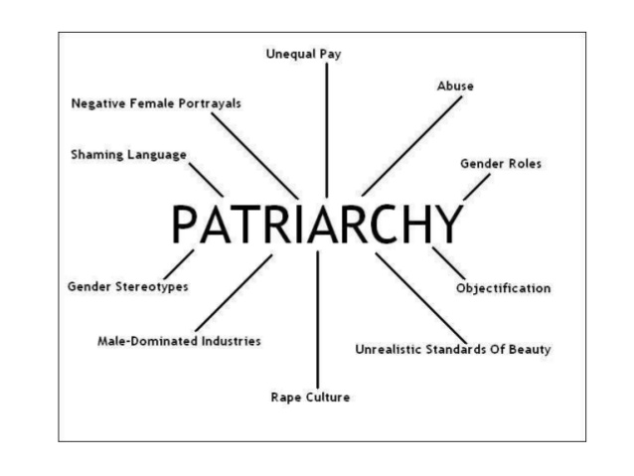
In Nigeria, women are denied certain inalienable rights.
Fact:
The patriarchal nature of most African states like Nigeria has denied some individuals like women and females in general the ability and access to exercise and enjoy the fundamental human rights. That is, women in African, Nigeria to be specific, are denied of certain inalienable right.

Slide 11
In Nigeria, women are denied certain inalienable rights.
Fact:
In political sector, there is less active participation of women. The rights and privileges of Nigerian women are denied in the political sector. This is evident in that there is a very low representation of women in the political sector and involvement in decision making of the nation. “Only 9% of those who stood for election in Nigeria’s April 2011 National assembly elections were women. Out of the 360 members of the House of the Representatives, only 25 are women, which is 6%.”

Slide 12
Consequences
Detriments to the growth of individual women in Nigeria societies.
A vacuum of untapped resources and potentials. The potentials in women would be wasted as a result of the society’s inability to see and utilise these hidden potentials because the society has been clouded with the mentality that women and girls are sex/gender with weaker vessel, inferior, objects of pleasure and thus has nothing to offer
This inequality and subordination of the female gender has spurred into existence (radical) feminism. The future consequence of which might be continuous hatred and violence in the society.

Slide 13
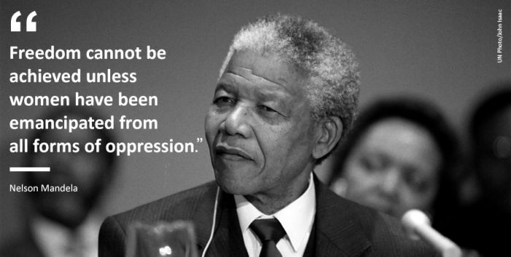

Way Forward: Basic Tools to Ameliorate Rights and Privileges Inequality in Nigeria

Slide 14
Way Forward: Basic Tools to Ameliorate Rights and Privileges Inequality in Nigeria
EDUCATION
Through education men and women can be taught to understand and value the essence of human rights and privileges.
Education will also make each individuals, both male and female, boys and girls, to understand their place in the society and disallow them to tamper with their counterparts’ right and privileges. If the right values and norms are inculcated in men and women, boys and girls, right from childhood, there will less cases of rights and privileges infringement and violation.
Through education, occupants of the society will become aware of when and when not their rights are infringed upon. They will also become aware of acts, such as treason, murder etc., that are capable of give usurping their ability to exercise the fundamental human rights. Also, education will enlighten the populace on the necessary actions to take when their rights are been violated.

Slide 15
Way Forward: Basic Tools to Ameliorate Rights and Privileges Inequality in Nigeria
MENTAL RE-ORIENTATION
A genuine amelioration of rights inequality must start with a “genuine mental re-orientation on the part of the individual person, man or woman, who must first apprehend a holistic perspective of the Female Principality as represented by woman, as an integral part of the consummate identity of the Absolute.”
If the mental conception is re-evaluated, such that men no longer conceive women as objects of pleasure and women also do not depict themselves as mere objects and tools, only then can there be a true motive for liberation in ensuring gender right equality.

Slide 16
Way Forward: Basic Tools to Ameliorate Rights and Privileges Inequality in Nigeria
IMPLEMENTATION OF LAWS
A strict implementation of laws of the land that are stipulated in the constitution must be enforced.
Irrespective of one’s tribe and race, one’s right ought not to be violated. As stipulated in the constitution, “no citizen of Nigeria shall be subjected to any disability or deprivation merely by reason of the circumstances of his birth.”
Nigerian constitution “guarantees every one the right to dignity of the human person … and…, it forbids that any person be subjected to torture or to inhuman or degrading treatment, or held in slavery or servitude or required to perform forced labour.”

Slide 17
Way Forward: Basic Tools to Ameliorate Rights and Privileges Inequality in Nigeria
GENDER MAINSTREAMING
Gender mainstreaming can be defined as a means of “assessing the implication for women and men of any planned action, including legislation, policies or programmes in any area and at all levels.” It entails making known and obvious to the populace their roles and duties in nation building in a bid to achieve gender and right equality.

Slide 18
CONCLUSION
In spite of any difference that could exist in the nature of each individual in the society, the respect of individuals’ rights will directly help in the growth of the society as a whole. The reciprocity in the respect of individuals’ rights will promote harmony in the society and influence that idea that could be used to promote the decisions of ruling the country. Women constitute an integral part in nation building and as such their roles and rights must not be undermined or jettisoned. In other to have an effective system that encourages development, there is need for a hybridisation of men and women, boys and girls, potentials and resources.

Slide 19


Slide 20


Role of Education:Culture and ChangE
Afolakemi O. Oredein

Slide 21
Structure of Presentation
Welcome & Introduction
Role of Education in Culture Change
Conclusion
Definition of Terms/Concepts
Culture & Education; Culture & Change

Slide 22
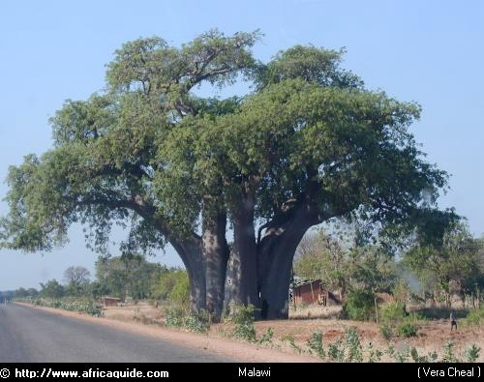
Baobab Tree
The baobab tree metaphor drives home the fact that knowledge needed for addressing the role of education in culture change goes beyond the capacity of a single effort

Slide 23

A group of scientists placed 5 monkeys in a cage and in the middle, a ladder with bananas on the top.

Slide 24
Every time a monkey went up the ladder, the scientists soaked the rest of the monkeys with cold water.

Slide 25
After a while, every time a monkey went up the ladder, others beat up the one on the ladder.

Slide 26
Scientists then decided to substitute one of the monkeys. The first thing, this new monkey did was to go up the ladder. Immediately, the other monkeys beat him up.
After several beatings, the new member learned not to climb the ladder even though he never knew why.

Slide 27
When 2nd monkey was substituted and the same thing occurred. The 1st monkey participated on the beating of the 2nd monkey. A 3rd monkey was changed and the same happened. The 4th was substituted and the beating was repeated and finally the 5th monkey was replaced.

Slide 28
What was left was a group of 5 monkeys that even though none ever received a cold shower, continued to beat up any monkey who attempted to climb up the ladder.

Slide 29
If it was possible to ask the monkeys why they would beat up all those who attempted to go up the ladder…..
You will all agree with me that the answer would be….
“I don’t know – that’s how things are done around here”
Does it sound familiar?

Slide 30
Why do we continue doing what we are doing if there is a different and even a better way?

Slide 31
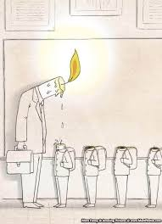
Meaning of Education
It is a process of giving and receiving a systematic instruction
A process of imparting or acquiring knowledge to bring positive changes in human life and behaviour
A process by which people acquire knowledge, skills, habits, values or attitudes
Three types:
Formal (Schools/Institutions-structured and subject oriented)
Informal (Practical adult learning, diversity in methods and content)
Non-formal (very long process, learning from experience, home, workplace, environment)

Slide 32

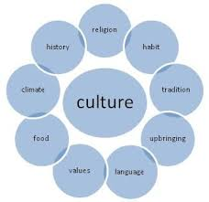
Meaning of Culture
It is the values beliefs and behaviour that form a group of people’ way of life
Is the characteristics and knowledge of a particular set or group of people
Elements of culture: religion, values, language, tradition and food among others
Culture could be material or non-material
Culture is passed from one generation to another
Culture can be individual, communal, national or world
Nigeria is so blessed that there about 250 ethnics and each ethnic has its culture

Slide 33

Meaning of Change
Is the modification of a society through innovation
It is simply an act or process through which something becomes different (Oredein, 2016)
It is the changes that has occur over time to the shared way of life of a group
It occurs when there is a contact with other culture
It can be said that it has a broad spectrum of interpretation
Change could be positive or negative
There is virtually nothing that does not experience change

Slide 34
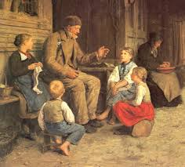
Culture and Education
Culture and education cannot be divorced from each other.
Culture and education are interdependent.
The cultural patterns of a society guide its educational patterns in:
Curriculum: The curriculum is prepared according to the culture of society.
Methods of teaching: Culture and methods of teaching are intimately connected. The changing cultural patterns of a society exert its influence upon the methods of teaching.
Discipline: Cultural values influence the concept of discipline.
Text Books: Textbooks are foster and promote cultural values and ideals.
Teacher: Is the integral member of the society. They infuse higher ideals and moral values in children.
School: Is a miniature of a society. Is the centre of promoting, moulding, reforming, and developing the cultural pattern of the society.

Slide 35

Culture and Change
Culture and change are tightly intertwined.
It is the repositioning of culture, that is, the reconstruction of the cultural concept of a society.
When change is initiated outside culture then there will be resistance.
Factors of cultural change are:
Contact: Contact between two society will obviously change the culture of both societies
Technological Evolution: Any technological evolution will bring a change in culture.
Geographical and Ecological Factor: This is a natural physical factor. Any change in physical features will automatically lead to a change in culture and the way of living

Slide 36
Role of Education in Cultural Change
Preservation of culture: Education is the only means through which this can be accomplished. Thus, education preserves the culture of a society.
Transmission of culture: The process of preservation includes the process of transmission from one generation to another.
Development of culture: The function of education is to bring the needed and desirable change in the cultural ideals and values for the progress and continued development of the society without which social progress cannot take place.
Continuity of culture: Culture is a life breadth of a society. Without which a society is bound to decay. Education upholds the continuity of culture through its diverse activities and programmes.
Development of personality: Education aims at developing the personality of a child. It employs diverse cultural patterns of thinking, behaviour and cultural values so that children are physically, mentally, morally, socially and intellectually develop with the development of society to the maximum extent.
Removal of cultural lag: Material culture develop at a faster speed due to scientific and technological inventions while non-material culture consisting of ideas, values and norms lags behind and create a gulf between the two. Education is the only means by which these gaps can be bridged.

Slide 37
Conclusion
Conclusion
Education and culture are interdependent and complementary to each other. There is a need that education should be related to our own culture. Education system in some ways is not related to Nigerian cultural heritage. A foreign system of education has been introduced without taking into account the cultural heritage. Modernization of education and cultural renaissance is needed to evolve education for its own culture. Education should transmit the culture to the new generation and transform the outlook of the young towards life in the light of the past; in the context of cross-cultural influences and in the light of the future requirements of the individual and the society.

Slide 38
The Way Forward
Government, curriculum planners and other stakeholders should make education a true reflection of Nigerian culture
Teachers should be active and participate in the process of change and innovation especially in the area of curriculum change
Formal, Informal and Non-formal education should preserve and transmit culture to the next generation.

Slide 39
References
Burnes, B. (2011) Introduction: Why Does Change Fail, and What Can We Do About It?, Journal of Change Management, 11:4, 445-450
Harris, A. (2003). Behind the classroom door: The challenge of organisational and pedagogical change. Journal of Educational Change, 4, pp. 369 - 382.
Oredein, A.O. (2016). Good leadership for national development: The inevitable fraternal twins and irresistible skills as matters arising. 6th Inaugural Lecture, Lead City University, Ibadan, Oyo State
Rogers, P., Meehan, P. and Tanner, S. (2006) Building a winning culture (Boston, MA: Bain & Company).
Smollan, R & Sayers, J. (2009) Organizational Culture, Change and Emotions: A Qualitative Study, Journal of Change Management, 9:4, 435-457
Starr, K. (2011). Principals and the politics of resistance to change. Educational Management Administration & Leadership, 39: 646

Slide 40


Slide 41


Slide 42
HAZARDS OF TEENAGE PREGNANCY
ANIFOWOSE, OLUWASEUN ADEOLA, PhD
B.A (OGUN), M.A (IBADAN), PhD (IBADAN), MSC BIOETHICS (LEUVEN, NETHERLANDS, ITALY)

Slide 43
OUTLINE
Introduction
Who is a teenager?
What is teenage pregnancy?
What are the likely causes of teenage pregnancy?
What are the hazard of teenage pregnancy?
How can we prevent teenage pregnancy?
Conclusion

Slide 44
INTRODUCTION
Teenage pregnancy remains a front burner in the societal discourse, an issue begging for its rightful place in our national life at appropriate quarters and one with great concerns

Slide 45
WHO IS A TEENAGER?
A teenager is a person aged between 13 and 19 years
The word teenager is another word for adolescent
Adolescence is a transitional phase of development between childhood and adulthood
They are called teenagers because their age number ends with ‘teen’
An eighteen or nineteen year old person is called a young adult. This varies in societies

Slide 46

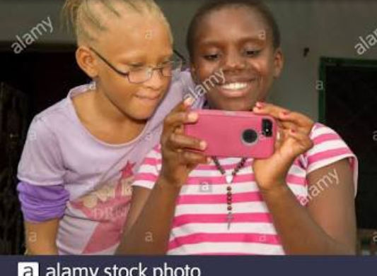
TEENAGERS

Slide 47
CHANGES DURING THE TEENAGE PERIOD
There are many changes that comes in the period when the girl is no longer referred to as a child
They have the brain of a young person but the body of an adult
The teenage years are unique period of growth and development
It is filled with energy, excitements and new experiences
Teenage experiences their teen years uniquely

Slide 48
CHANGES DURING THE TEENAGE PERIOD
1. They go through hormonal and physical changes
2. Rebellious: at this period, they start to resist authority and want to be independent from their parents. Sometimes, they engage in emotional verbal conflict with family
3. Energetic: some teenagers at this age become so energetic, some become adventurous , overlook the risk of sexual activity, drug experimentation.
4. Intellectual growth : ability to understand abstract things . Some even begin to question their parents

Slide 49
CHANGES DURING THE TEENAGE PERIOD
Being a period of transformation, it is characterized by a lot of instabilities and sometimes, outright confusion.

Slide 50
WHAT IS TEENAGE PREGNANCY?
A teenage pregnancy is a pregnancy in female
under the age of 20

Slide 51
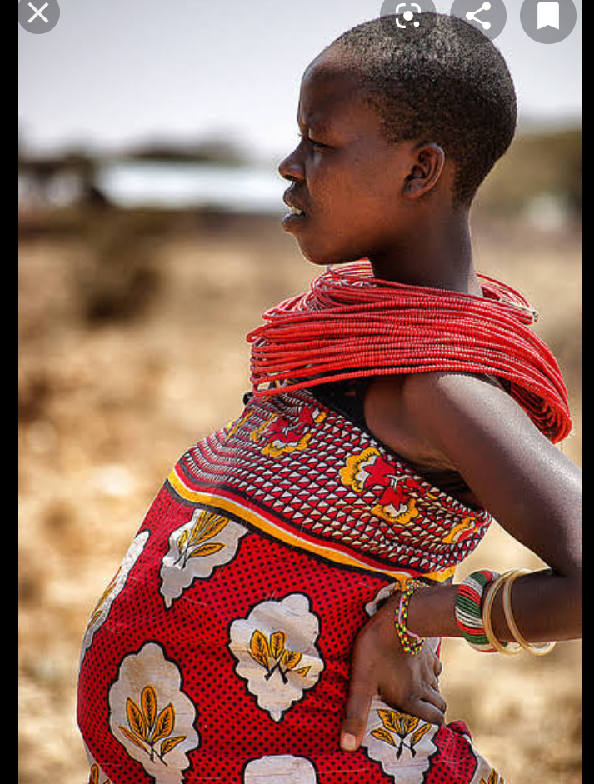
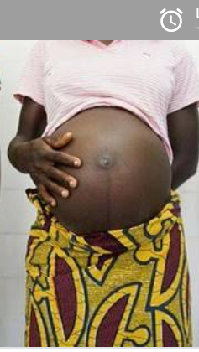
TEENAGE PREGNANT GIRLS

Slide 52
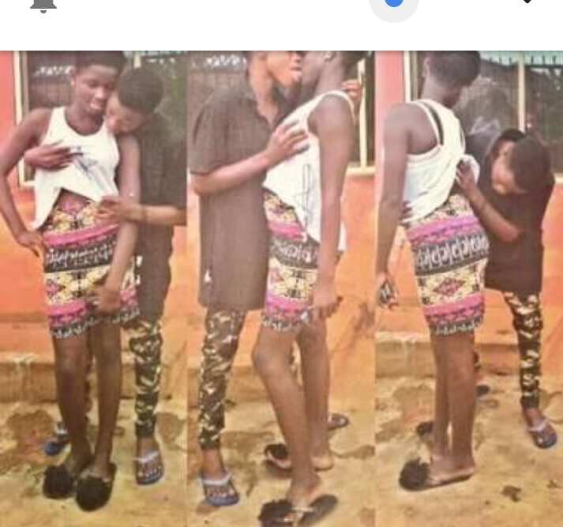
CAUSES OF TEENAGE PREGNANCY
1. Lack of education and information about sex
2. Peer pressure
3. Early engagement in sexual activities

Slide 53
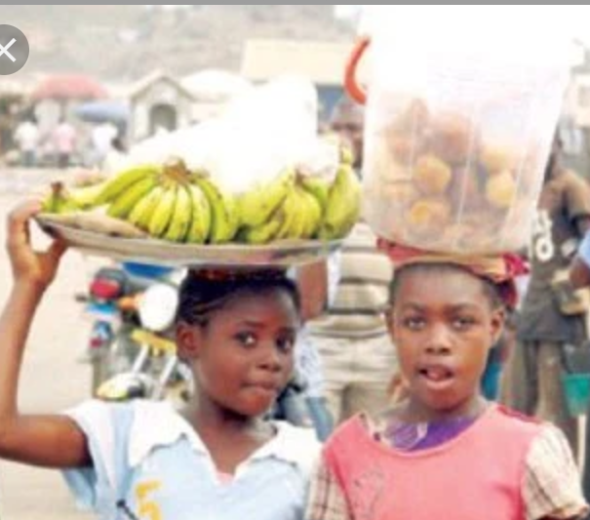
CAUSES OF TEENAGE PREGNANCY
4. Intake of drug/ alcohol
5. Low social economic status: some of these girls are vulnerable for many reasons ( no role model, lack of education, hawking etc.)

Slide 54
CAUSES OF TEENAGE PREGNANCY
6. Broken homes
7. Sexual Abuse
8. Incest
9. Media influence (Pornography)

Slide 55
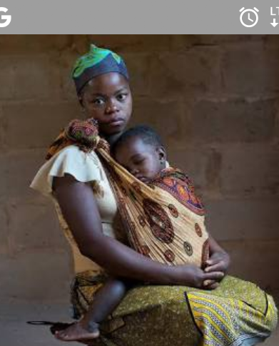
HAZARD OF TEENAGE PREGNANCY
1. Inability to complete their education
2. No resources to care for the child

Slide 56
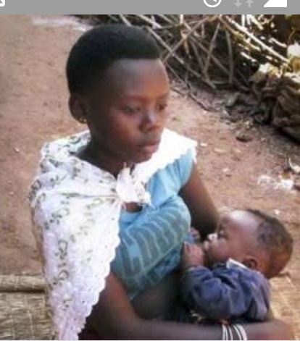
HAZARD OF TEENAGE PREGNANCY
3. Inability to sustain healthy eating habits to produce healthy babies
4. Bad precedent

Slide 57
HAZARD OF TEENAGE PREGNANCY
5. Health risk: Young girl can suffer from
(a.) anaemia: reduction in the number of red blood cells: making them feel weak and tired)
(b.) Preeclampsia: pregnancy related high blood pressure (This can harm the kidneys)
6. Depression (postnatal depression)
7. Suicidal tendencies resulting from depression
8. Financial disability : many failed to attend prenatal check up for this reason

Slide 58

HAZZARD OF TEENAGE PREGNANCY
9. High risk of obstructed labor
10. Premature or underweight
babies

Slide 59
HAZARD OF TEENAGE PREGNANCY
11.Unsafe Abortion to cover for shame
12. High level of mortality rate because of the difficult in delivering the baby
13.The pelvic bones in girls below 16years are still in the process of growing
14. Studies reveals stillbirth in some teens

Slide 60
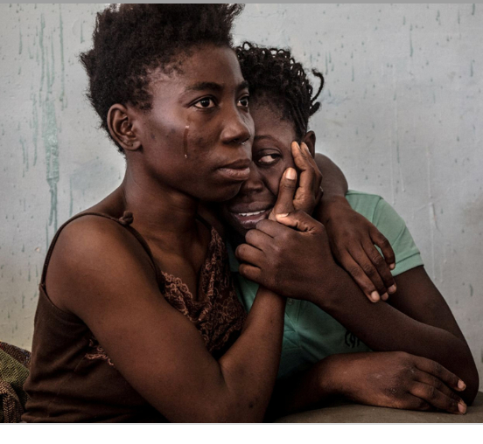
HAZARD OF TEENAGE PREGNANCY
15. Risk of contacting HIV and other related sexually transmitted diseases

Slide 61
HAZARD OF TEENAGE PREGNANCY: The Child
16. Risk of transmitting HIV to the child
17. Risk of Iodine Deficiency
( This is essential for physical and mental development . The deficiency of Iodine increases the risk of the developing foetus sustaining brain damage which would lead to mental retardation and disorder of the nervous system)
18. Their children are also exposed to physical abuse that their parent suffers

Slide 62
HAZARDS OF TEENAGE PREGNANCY: The Child
19. No monitoring and mentoring
20. No fatherly role
21. The circle of suffering continues for the child
22. Success academically is slim

Slide 63
HOW CAN WE PREVENT TEENAGE PREGNANCY?
1. Sex Education
2. Sex prevention (Abstinence)
3. Building confidence in children
4. Parents must be vigilant
5. Proper use of contraception

Slide 64
HOW CAN WE PREVENT TEENAGE PREGNANCY
6. Avoid entrusting your children in the hands of neighbours, friends, uncles, and family members etc.
7.Be friends with them so that they can trust you
9. Encourage them to say anything any time to you: don’t be Lion parents
10. Teach them to say NO when need be (wherever you go…)

Slide 65
CONCLUSION
As parents, we have a role to play in curbing the menace of teenage pregnancy
Although, family challenges and societal pressure have made many parents fail in their responsibilities
Yet the family remains the best place to harm our teeming youths with the necessary information for life and living.
Therefore, as parents, we have the unenviable task of moulding the future of our teeming teenagers and playing pivotal roles in stemming the rising tide of teenage pregnancy in our time. As the saying goes, “charity begins at home”.

Slide 66
APPRECIATION
THANK YOU ALL FOR LISTERNING

Slide 67
Role of Education: Culture and Change
Afolakemi O. Oredein

Slide 68
Structure of Presentation
Welcome & Introduction
Role of Education in Culture Change
Conclusion
Definition of Terms/Concepts
Culture & Education; Culture & Change

Slide 69
Baobab Tree
The baobab tree metaphor drives home the fact that knowledge needed for addressing the role of education in culture change goes beyond the capacity of a single effort

Slide 70
A group of scientists placed 5 monkeys in a cage and in the middle, a ladder with bananas on the top.

Slide 71
Every time a monkey went up the ladder, the scientists soaked the rest of the monkeys with cold water.

Slide 72
After a while, every time a monkey went up the ladder, others beat up the one on the ladder.

Slide 73
Scientists then decided to substitute one of the monkeys. The first thing, this new monkey did was to go up the ladder. Immediately, the other monkeys beat him up.
After several beatings, the new member learned not to climb the ladder even though he never knew why.

Slide 74
When 2nd monkey was substituted and the same thing occurred. The 1st monkey participated on the beating of the 2nd monkey. A 3rd monkey was changed and the same happened. The 4th was substituted and the beating was repeated and finally the 5th monkey was replaced.

Slide 75
What was left was a group of 5 monkeys that even though none ever received a cold shower, continued to beat up any monkey who attempted to climb up the ladder.

Slide 76
If it was possible to ask the monkeys why they would beat up all those who attempted to go up the ladder…..
You will all agree with me that the answer would be….
“I don’t know – that’s how things are done around here”
Does it sound familiar?

Slide 77
Why do we continue doing what we are doing if there is a different and even a better way?

Slide 78
Meaning of Education
It is a process of giving and receiving a systematic instruction
A process of imparting or acquiring knowledge to bring positive changes in human life and behaviour
A process by which people acquire knowledge, skills, habits, values or attitudes
Three types:
Formal (Schools/Institutions-structured and subject oriented)
Informal (Practical adult learning, diversity in methods and content)
Non-formal (very long process, learning from experience, home, workplace, environment)

Slide 79
Meaning of Culture
It is the values beliefs and behaviour that form a group of people’ way of life
Is the characteristics and knowledge of a particular set or group of people
Elements of culture: religion, values, language, tradition and food among others
Culture could be material or non-material
Culture is passed from one generation to another
Culture can be individual, communal, national or world
Nigeria is so blessed that there about 250 ethnics and each ethnic has its culture

Slide 80
Meaning of Change
Is the modification of a society through innovation
It is simply an act or process through which something becomes different (Oredein, 2016)
It is the changes that has occur over time to the shared way of life of a group
It occurs when there is a contact with other culture
It can be said that it has a broad spectrum of interpretation
Change could be positive or negative
There is virtually nothing that does not experience change

Slide 81
Culture and Education
Culture and education cannot be divorced from each other.
Culture and education are interdependent.
The cultural patterns of a society guide its educational patterns in:
Curriculum: The curriculum is prepared according to the culture of society.
Methods of teaching: Culture and methods of teaching are intimately connected. The changing cultural patterns of a society exert its influence upon the methods of teaching.
Discipline: Cultural values influence the concept of discipline.
Text Books: Textbooks are foster and promote cultural values and ideals.
Teacher: Is the integral member of the society. They infuse higher ideals and moral values in children.
School: Is a miniature of a society. Is the centre of promoting, moulding, reforming, and developing the cultural pattern of the society.

Slide 82
Culture and Change
Culture and change are tightly intertwined.
It is the repositioning of culture, that is, the reconstruction of the cultural concept of a society.
When change is initiated outside culture then there will be resistance.
Factors of cultural change are:
Contact: Contact between two society will obviously change the culture of both societies
Technological Evolution: Any technological evolution will bring a change in culture.
Geographical and Ecological Factor: This is a natural physical factor. Any change in physical features will automatically lead to a change in culture and the way of living

Slide 83
Role of Education in Cultural Change
Preservation of culture: Education is the only means through which this can be accomplished. Thus, education preserves the culture of a society.
Transmission of culture: The process of preservation includes the process of transmission from one generation to another.
Development of culture: The function of education is to bring the needed and desirable change in the cultural ideals and values for the progress and continued development of the society without which social progress cannot take place.
Continuity of culture: Culture is a life breadth of a society. Without which a society is bound to decay. Education upholds the continuity of culture through its diverse activities and programmes.
Development of personality: Education aims at developing the personality of a child. It employs diverse cultural patterns of thinking, behaviour and cultural values so that children are physically, mentally, morally, socially and intellectually develop with the development of society to the maximum extent.
Removal of cultural lag: Material culture develop at a faster speed due to scientific and technological inventions while non-material culture consisting of ideas, values and norms lags behind and create a gulf between the two. Education is the only means by which these gaps can be bridged.

Slide 84
Conclusion
Education and culture are interdependent and complementary to each other. There is a need that education should be related to our own culture. Education system in some ways is not related to Nigerian cultural heritage. A foreign system of education has been introduced without taking into account the cultural heritage. Modernization of education and cultural renaissance is needed to evolve education for its own culture. Education should transmit the culture to the new generation and transform the outlook of the young towards life in the light of the past; in the context of cross-cultural influences and in the light of the future requirements of the individual and the society.

Slide 85
The Way Forward
Government, curriculum planners and other stakeholders should make education a true reflection of Nigerian culture
Teachers should be active and participate in the process of change and innovation especially in the area of curriculum change
Formal, Informal and Non-formal education should preserve and transmit culture to the next generation.

Slide 86
References
Burnes, B. (2011) Introduction: Why Does Change Fail, and What Can We Do About It?, Journal of Change Management, 11:4, 445-450
Harris, A. (2003). Behind the classroom door: The challenge of organisational and pedagogical change. Journal of Educational Change, 4, pp. 369 - 382.
Oredein, A.O. (2016). Good leadership for national development: The inevitable fraternal twins and irresistible skills as matters arising. 6th Inaugural Lecture, Lead City University, Ibadan, Oyo State
Rogers, P., Meehan, P. and Tanner, S. (2006) Building a winning culture (Boston, MA: Bain & Company).
Smollan, R & Sayers, J. (2009) Organizational Culture, Change and Emotions: A Qualitative Study, Journal of Change Management, 9:4, 435-457
Starr, K. (2011). Principals and the politics of resistance to change. Educational Management Administration & Leadership, 39: 646

